Slide 1
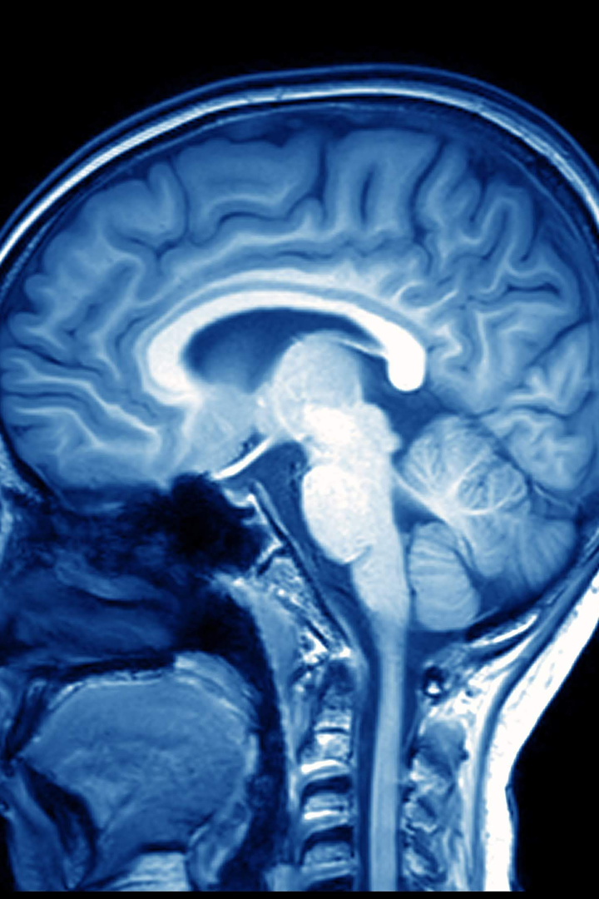
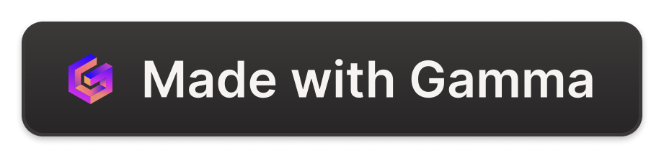
3D Tumor segmentation using UNET architecture
By Hemang Joshi

Slide 2

Objective
To develop a deep learning model for segmenting brain tumors into three categories from MRI images.
This project aims to utilize advanced machine learning techniques to analyze MRI images of the brain and accurately classify different types of tumors. By developing a deep learning model, we can enhance the accuracy and efficiency of tumor segmentation, which is crucial for accurate diagnosis and treatment planning.
With the increasing prevalence of brain tumors and the complexity of tumor segmentation, this project addresses the need for automated and reliable methods for tumor classification. By leveraging the power of deep learning algorithms, we can potentially improve the effectiveness of tumor detection and provide valuable insights for medical professionals.

Slide 3

Utilization for Society
Early and accurate detection of brain tumors using non-invasive MRI images can have a significant impact on patient outcomes. By identifying tumors at an early stage, doctors can initiate treatment promptly, potentially improving the chances of successful outcomes.
MRI imaging techniques offer a non-invasive approach to visualize the brain and identify abnormalities. Through the analysis of MRI images, medical professionals can identify the presence of tumors and assess their characteristics, such as size, location, and aggressiveness.
With early detection, patients can receive timely and appropriate treatment interventions. This includes surgical removal of tumors, radiation therapy, or chemotherapy. Prompt diagnosis and treatment can help prevent the spread of tumors to surrounding tissues and vital structures, ultimately improving patient prognosis.

Slide 4
Technology Used
Python & TensorFlow
Keras & scikit-learn
OpenCV & Image Processing
The project utilizes the power of Python programming language along with TensorFlow for building and training the deep learning model.
Keras and scikit-learn libraries are employed for model development, evaluation, and performance optimization.
OpenCV, a popular computer vision library, is integrated to perform image processing techniques for preprocessing and analysis of MRI images.

Slide 5

API/Specialty
The project implements neural imaging techniques and utilizes specialized medical imaging libraries like Nilearn and Nibabel for MRI data processing.
With the help of these libraries, the project is able to analyze and extract valuable insights from MRI data, enabling researchers and medical professionals to better understand and diagnose neurological conditions.
By leveraging neural imaging techniques, the project aims to advance the field of medical imaging and contribute to the development of innovative diagnostic tools and treatment strategies.

Slide 6
Front End
Streamlit App
User Experience
A user-friendly Streamlit web application has been developed to provide an intuitive interface for interacting with the brain tumor segmentation model.
The Streamlit app empowers users to easily upload MRI images, visualize tumor segmentations, and access diagnostic information.

Slide 7
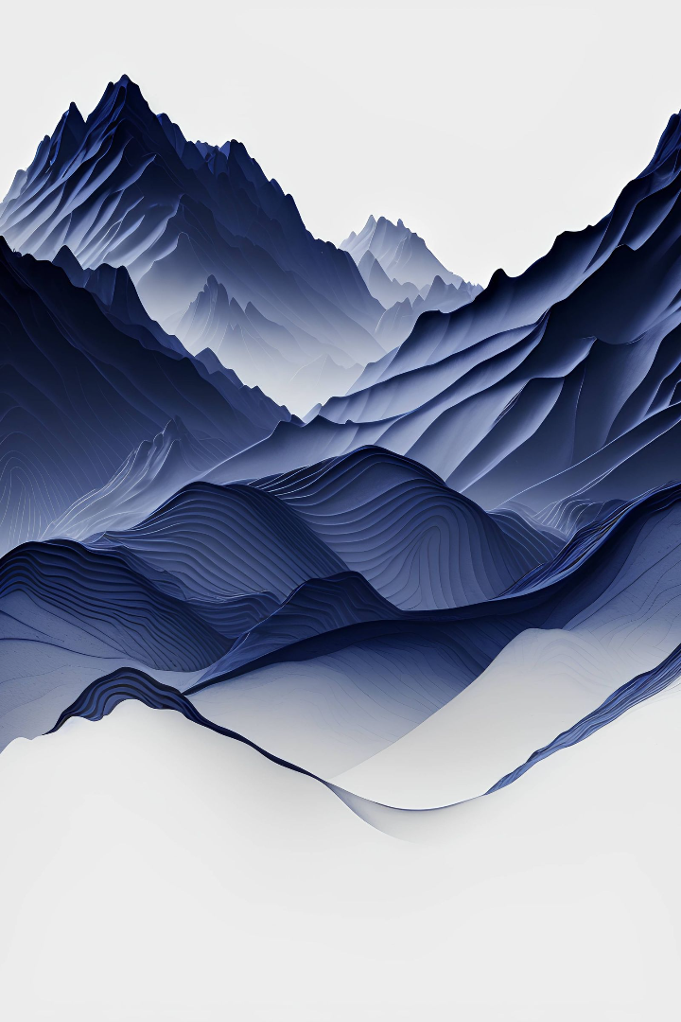
Backend Connectivity
Cloud-based infrastructures like Github or AWS offers a multitude of advantages when it comes to model deployment and scalability. With the power of the cloud, we can ensure efficient and reliable performance for our applications and services.
Furthermore, with cloud-based infrastructure, we can achieve high availability and reliability for your applications. The cloud offers redundant systems and automatic failover mechanisms, ensuring that our services remain accessible and operational in the event of any unforeseen issues.

